Slide 2
Green hydrogen demand projections
A system dynamics approach at establishing sectoral green hydrogen demand curves

Slide 3
Two-fold motivation
The transition is driven by private investments - funded by EU and governments.
Assessment of sectoral technology competitiveness can guide policy makers to crucial areas and technologies in need of funding.
By quantifying the competitiveness gap, the level of funding required can also be estimated.
Policy perspective
The investor perspective
Levelized costs drive long-term investment decisions in competitive markets.
Establishing a green hydrogen demand curve informs investors about off taker prospects.
By correctly assessing the impacts of implemented policies such as the ETS, no-regret investments in non-renewable technologies can be deterred.
The green energy transition in hard-to-abate sectors have ambitious goals in EU’s net zero 2050 targets.

Slide 4
Research question
Focus is on the demand side of the transition to green hydrogen (and other renewable) technologies.
A system dynamics investment model is built to assess investment flows based on levelized costs of competing technologies.
RQ proposals:
What level of diffusion of green hydrogen technologies can we expect in European industry and transport sectors?
How is a hydrogen demand curve established using simple cost projections and a system dynamics diffusion model framework?
What are the sector specific willingness-to-pay for green hydrogen?

Slide 5
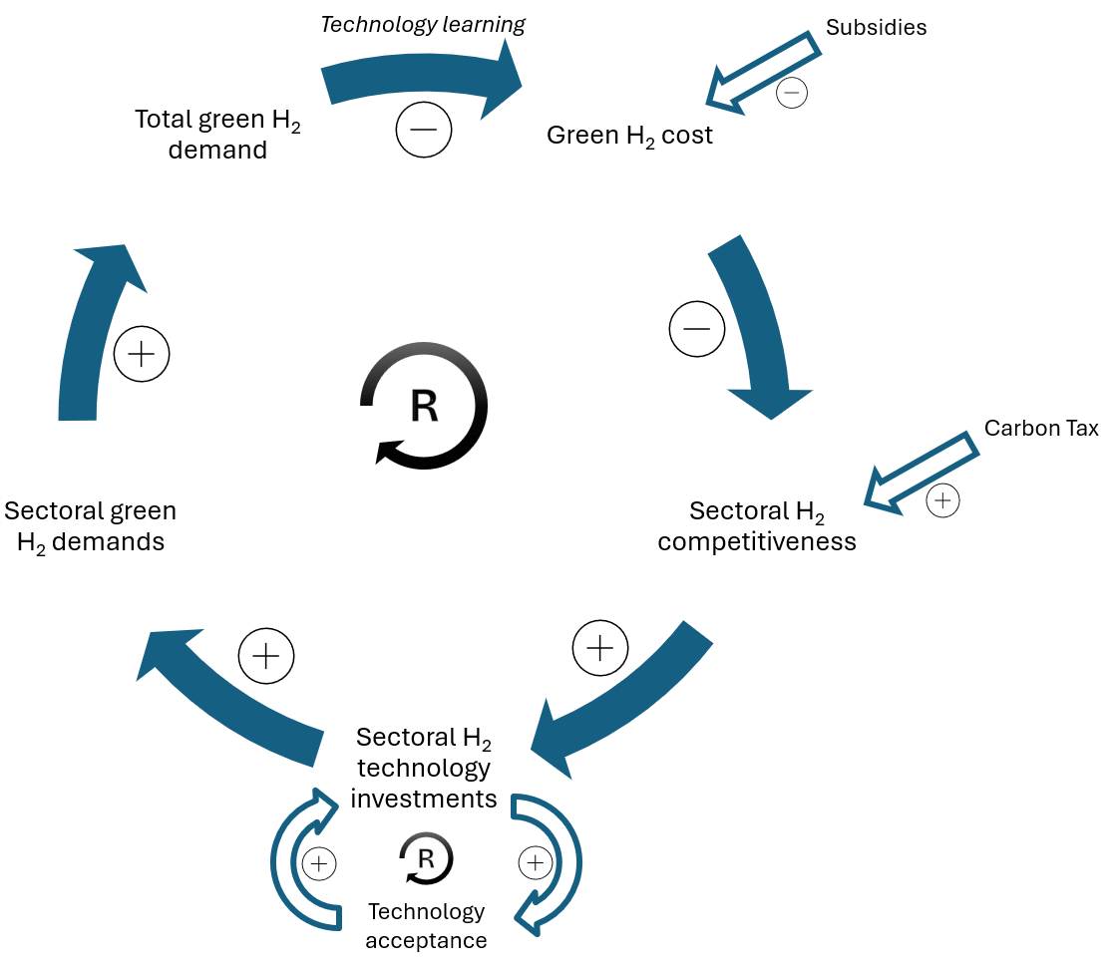
Methodology
Focusing on sectors, where hydrogen is expected to play a role.
Shipping, ammonia for fertilizers, steel production, etc.
System dynamics model which parallellizes each sector’s ‘separate’ transition.
Induces a ”Total green H2 demand” which drives an endogenous, shared learning curve for electrolysis.
Cost driven model, also incorporating system ‘inertia’, technology acceptance, and behavioural aspects.
Main feedback loop in the system dynamics model.

Slide 6
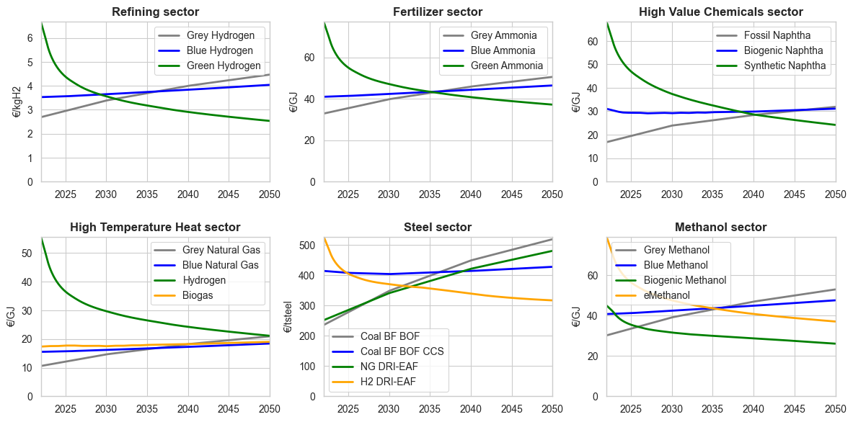
Projecting the sectoral technology costs
Projections are based on assumed ressource prices (i.e. fossil fuels, electricity, emissions) as well as capital cost estimates.
The cost used for each sector represents only costs unique to each technology (e.g. iron cost is excluded from steel)

Slide 7
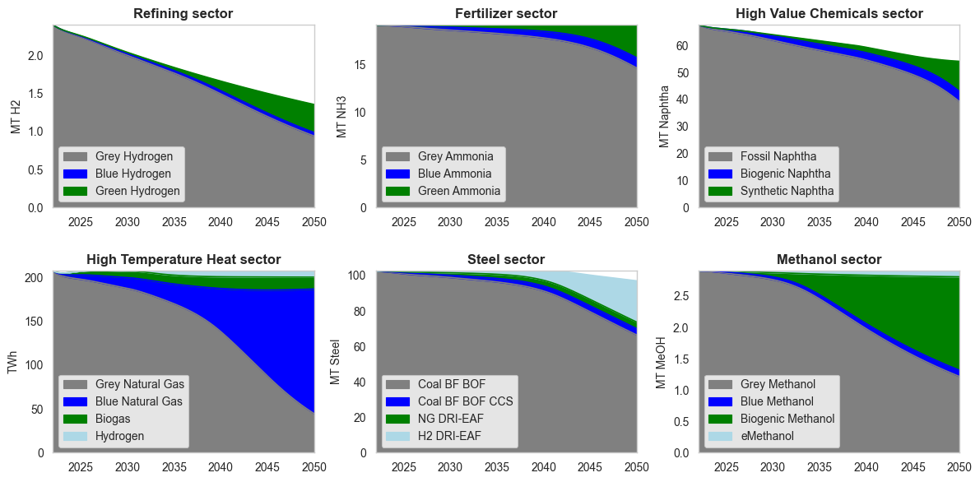
Diffusion of competing technologies
Total activity levels are predetermined.
Investment flow is limited by replacement rate and distributed by competitiveness.

Slide 8
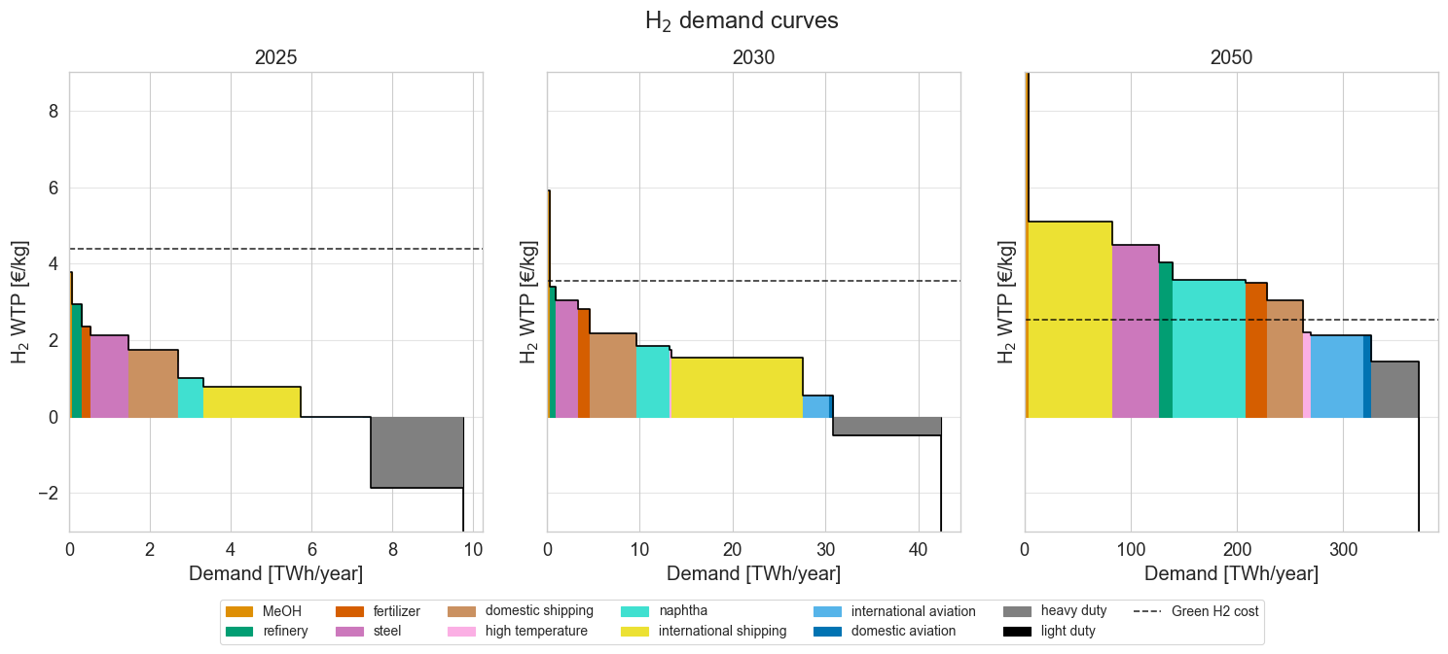
Constructing the hydrogen demand curve
Grey dotted line is the assumed cost of green hydrogen production – derived based on the endogenous learning curve.
Willingness-to-pay for green H2 increases primarily due to increases in emission costs for conventional technologies.

Slide 9
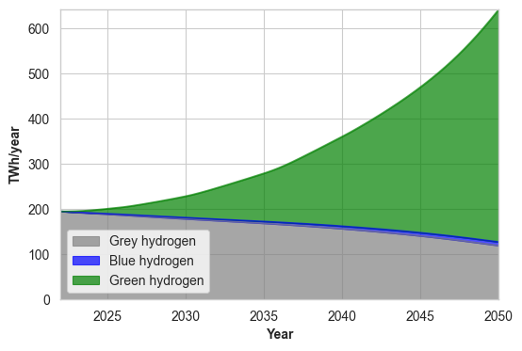
Overall hydrogen demand projection
Initially, a base consumption of grey hydrogen is seen in fertilizer production and oil refining.
No retrofitting of SMR is modelled, limiting the investments in blue H2 for these sectors.
Green H2 demand is 500 TWh in 2050.

Slide 10
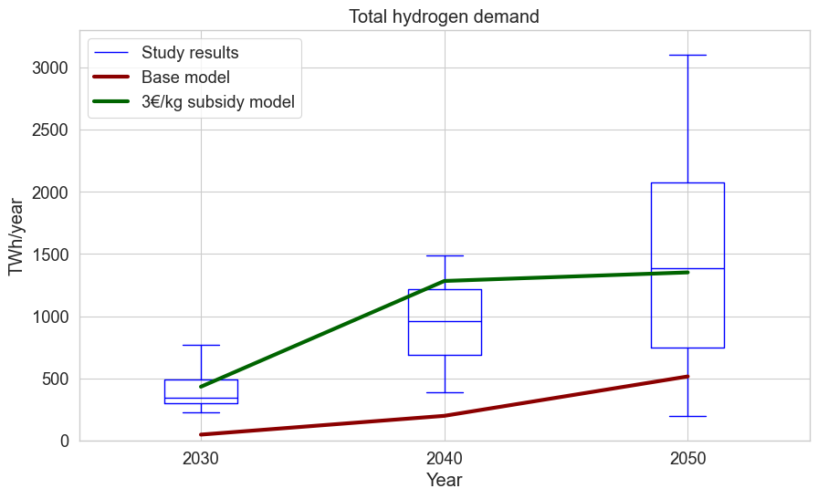
Subsidizing the production of green hydrogen
A literature review of other studies’ green hydrogen demand projections, show that the base case hydrogen demand is significantly lower than what other studies estimate.
A 3 €/kg subsidy from 2025 to 2035 is introduced.
Induces a large boost of green H2 adoption, which then ends up in line with what other studies predict.

Slide 11
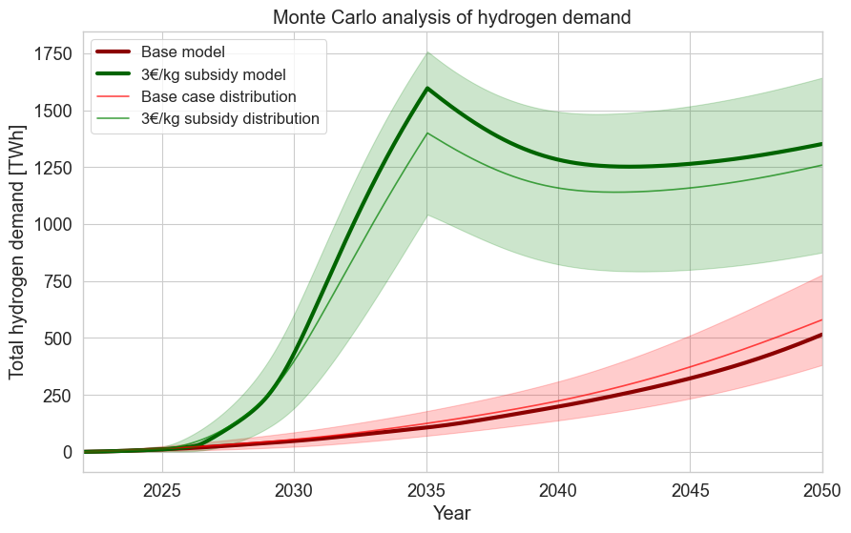
Investigating the likely range of
Distributions are based on Monte Carlo simulations of the system dynamics model by varying the 8 most influential model parameters and assumptions.
The thick lines represent the base case hydrogen demand projection with and without subsidies.
The model results are much more volatile when introduced to a large ‘market disturbance’ such as the subsidy.

Slide 12
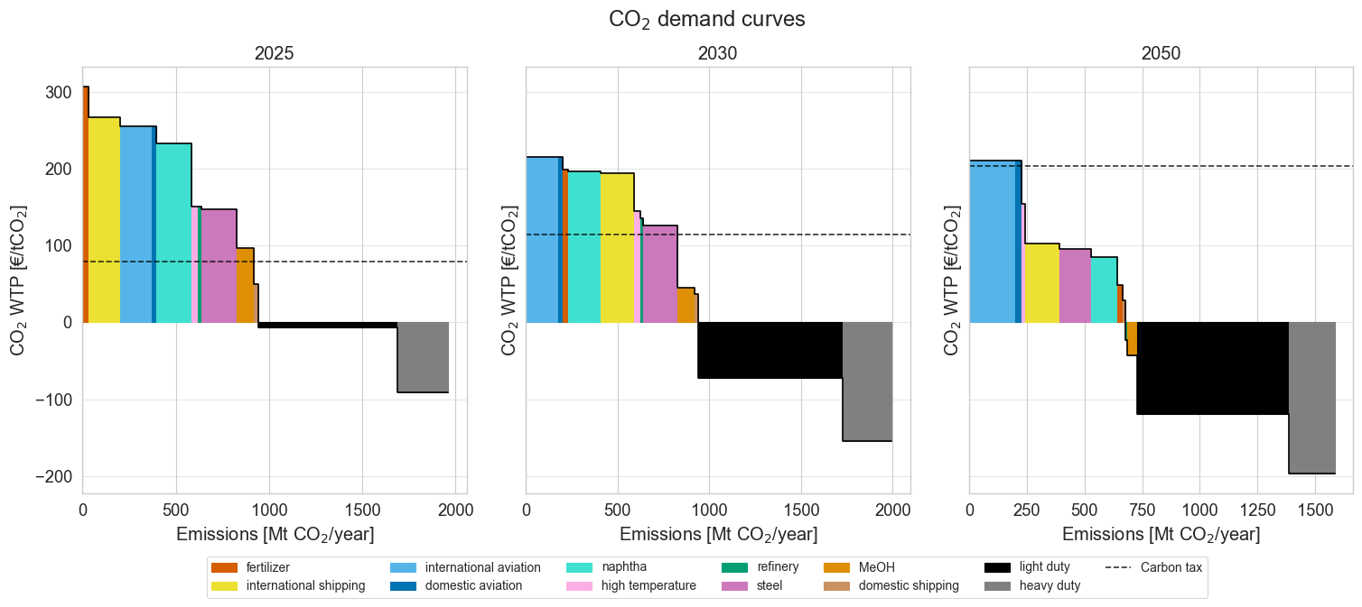
Establishing a CO2 emissions demand curve for conventional technologies

